Slide 1
Students as Scholars
Participation in open research and publishing practices: the case of the Communications Undergraduate Journal at Dublin City University
Alexander Kouker | Ronan Cox | Jim Rogers

Slide 2
cujournal.ie
Course-based open-access undergraduate journal

Slide 3
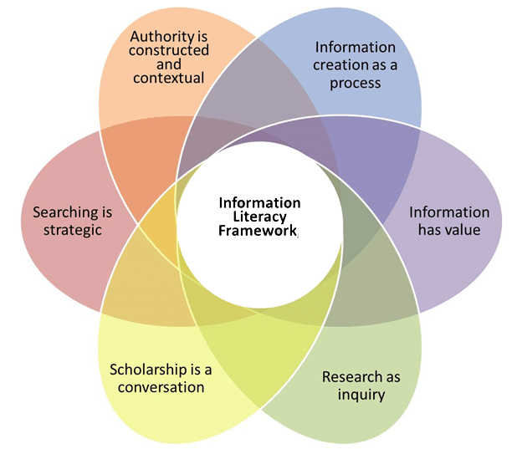
Library Role
Supporting the development of information fluency

Slide 4
Faculty Role
Reconceptualising the role of the student
Developing students as ‘authors’
Reconceptualising the role of the student/faculty relationship
Collaborative learning and pedagogical facilitation
Positioning students as scholars, and decentring Faculty as information experts into a facilitation role
So, as such, reimagining academic (social) organisation at the undergraduate level

Slide 5
What Next
Expand remit of journal (content and format)
Multimedia submissions
Collaborate with other institutions
Seek submissions from other third level institutions, e.g., UK-based Comms school

Slide 6
Questions
alexander.kouker@dcu.ie
ronan.cox@dcu.ie
jim.rogers@dcu.ie
Sources:
Montgomery, L. and Neylon, C. (2019) ‘The value of a journal is the community it creates, not the papers it publishes’, Impact of Social Sciences, 29 March. Available at: https://blogs.lse.ac.uk/impactofsocialsciences/2019/03/29/the-value-of-a-journal-is-the-community-it-creates-not-the-papers-it-publishes/ (Accessed: 4 September 2023).
Thorup, S. (no date) OLD -- Information Literacy Guide for Faculty: Framework for Information Literacy for Higher Education, Northwest Arkansas Community College. Available at: https://library.nwacc.edu/infolitforfaculty/framework (Accessed: 4 September 2023).
Lombard, E. (2016) ‘Information Fluency: Not Information Literacy 2.0’, The Journal of Academic Librarianship, 42(3), pp. 281–283. Available at: https://doi.org/10.1016/j.acalib.2016.04.006.

